Slide 1

Sqoop
Data Imports
Data Exports
Integration with Hadoop Ecosystem
http://sqoop.apache.org
Content Version : v2.0

Slide 2
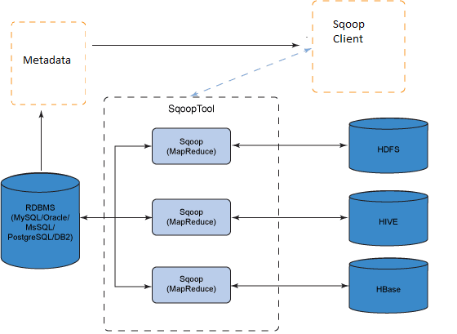
SQOOP…
Sqoop is used widely in industry as it is going to be your first apache product from the minute you have decided to move from relational DB to Hadoop ecosystem
Working

Slide 3
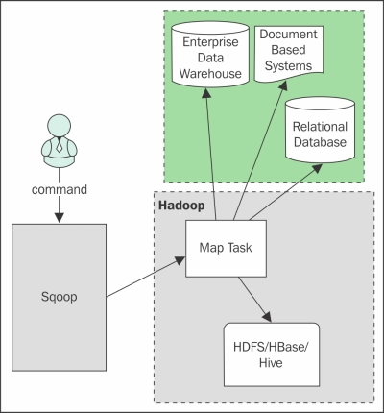
Sqoop Architecture

Slide 4
SQOOP…
Working in Step By Step:
Step 1:Sqoop sends the request to Relational DB to send the return the meta data information about the table(Metadata here is the data about the table in relational DB)
Step 2: From the received information it will generate the java classes (Reason why you should have java configured before get it working-Sqoop internally uses jdbc API to generate data).
Step 3:Now sqoop (As its written in java –tries to package the compiled classes to be able to generate table structure) , post compiling creates jar file(Java packaging standard)

Slide 5
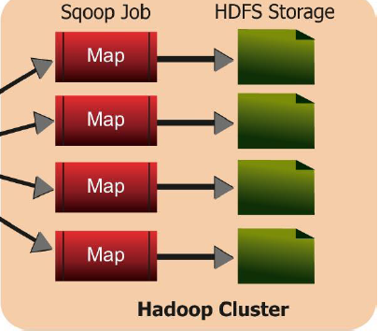
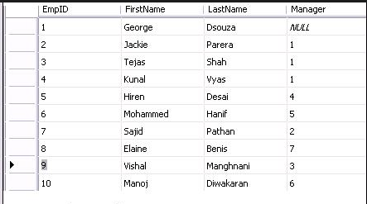
SQOOP…
1
2
3
4
By Default, Sqoop runs 4 mappers to import/export data.

Slide 6
Load Movie data to SQL
Move the below files to Linux home path using winscp.
Connect to the MySQL server using the mysql command-line client
mysql -h 101.53.130.146 -u sandeepm -p
use sandeepm
Execute the movie-schema.sql script to create the database structure
source mysql_data/movie-schema.sql
Show tables;
Execute the movie-data.sql script to populate the data in created tables;
source mysql_data/movie-data.sql
select count(*) from actor;

Slide 7
Import Data from MySQL to Hadoop
Load sample data to a target HDFS directory
sqoop import --driver com.mysql.jdbc.Driver --connect jdbc:mysql://101.53.130.146/sandeepm --table actor --delete-target-dir --target-dir 'sqoopdata' --username sandeepm -P
Load multiple table data to same base directory
sqoop import --driver com.mysql.jdbc.Driver --connect jdbc:mysql://101.53.130.146/sandeepm --table city --delete-target-dir --warehouse-dir 'sqoopdata' --username sandeepm -P
To load password from local file
sqoop import --connect jdbc:mysql://101.53.130.146/sandeepm --table actor --delete-target-dir --target-dir 'sqoopdata' --username sandeepm --password-file file:////home/sandeepm/pwd/password.txt
sqoop import --connect jdbc:mysql://101.53.130.146/sandeepm --table actor --delete-target-dir --target-dir 'sqoopdata' --username sandeepm --password-file /user/sandeepm/pwd/password.txt
To fetch specific columns with where condition and save output in tab separated than comma
sqoop import --driver com.mysql.jdbc.Driver --connect jdbc:mysql://101.53.130.146/sandeepm --username sandeepm -P --table film --delete-target-dir --warehouse-dir 'sqoopdata' --fields-terminated-by '\t' --columns 'title, rating' --where " rental_rate >3.00"

Slide 8
SQOOP…
Lets Understand it in terms of what would have happened technically
Sqoop fires and import request
Internally what it needs to know is what is min and max primary key value is in there
Select min(emp_id) as min_value ,max(emp_id) as max_value from table
And then for each mapper
Select * from employee where emp_id between min_value and max_value(Scope of each mapper)

Slide 9
Other Imports
Import all tables
sqoop import-all-tables --connect jdbc:mysql://101.53.130.146/sandeepm --username sandeepm -P --warehouse-dir 'sqoopdata1' --exclude-tables film,actor,city,customer_list
There should not be any gap between exclude table list names
Controlling the import parallelism (8 parallel tasks):
sqoop import --driver com.mysql.jdbc.Driver --connect jdbc:mysql://101.53.130.146/sandeepm --table city --delete-target-dir --warehouse-dir 'sqoopdata' --username sandeepm -P -m 8
Storing data in other than text format
sqoop import --driver com.mysql.jdbc.Driver --connect jdbc:mysql://101.53.130.146/sandeepm --table city --delete-target-dir --warehouse-dir 'sqoopdata' --username sandeepm -P --as-sequencefile
sqoop import --driver com.mysql.jdbc.Driver --connect jdbc:mysql://101.53.130.146/sandeepm --table city --delete-target-dir --warehouse-dir 'sqoopdata' --username sandeepm -P -- as-avrodatafile
sqoop import --driver com.mysql.jdbc.Driver --connect jdbc:mysql://101.53.130.146/sandeepm --table city --delete-target-dir --warehouse-dir 'sqoopdata' --username sandeepm -P -- as-parquetfile

Slide 10
Compressing Imported Data
default-compress files to GZip (.gz )
sqoop import --driver com.mysql.jdbc.Driver --connect jdbc:mysql://101.53.130.146/sandeepm --table city --delete-target-dir --warehouse-dir 'sqoopdata_gz' --username sandeepm -P --compress
BZip2Codec
sqoop import --driver com.mysql.jdbc.Driver --connect jdbc:mysql://101.53.130.146/sandeepm --table city --delete-target-dir --warehouse-dir 'sqoopdata_Bzip2' --username sandeepm -P --compress --compression-codec org.apache.hadoop.io.compress.BZip2Codec
Snappy
sqoop import --driver com.mysql.jdbc.Driver --connect jdbc:mysql://101.53.130.146/sandeepm --table city --delete-target-dir --warehouse-dir 'sqoopdata_snappy' --username sandeepm -P --compress --compression-codec org.apache.hadoop.io.compress.SnappyCodec
choose any other codec for any other type of compression

Slide 11
SQOOP EVAL, codegen Commands
List MySQL database list using sqoop command
sqoop list-databases --connect jdbc:mysql://101.53.130.146/ --username sandeepm -P
List table of mysql database
sqoop list-tables --connect jdbc:mysql://101.53.130.146/sandeepm --username sandeepm -P
SQOOP EVAL
sqoop eval --connect jdbc:mysql://101.53.130.146/sandeepm --query 'select * from actor limit 10' --username sandeepm -P
Eval tool allows users to run SQL queries; prints results on console.
Load sample data with output directory and java package
sqoop import --connect jdbc:mysql://101.53.130.146/sandeepm --table actor --delete-target-dir --warehouse-dir 'sqoopdata' --username sandeepm -P --package-name org.mysample --outdir '/home/sandeepm/sqoop-package'
ls sqoop-package/org/mysample/
codegen tool can be used to regenerate code if Java source file is by chance lost.
sqoop codegen --connect jdbc:mysql://101.53.130.146/sandeepm --table actor --username sandeepm -P

Slide 12
Incremental Imports (Append)
Sqoop supports two types of incremental imports:
Append mode: when importing a table where new data rows are continually being added with increasing row id values but no updated to existing data.
Insert few records to actor table of mysql
insert into actor values(201, "Robin", "Apoto", "2006-02-15 04:34:33");
insert into actor values(202, "Madhav", "Jani", "2006-02-15 04:34:33");
insert into actor values(203, "Sanjay", "Krishnan", "2006-02-15 04:34:33");
sqoop import --connect jdbc:mysql://101.53.130.146/sandeepm --username sandeepm --password-file /user/sandeepm/pwd/password.txt --table actor --target-dir 'sqoopdata/actor' --check-column actor_id --incremental append --last-value 200 -m 1
specify the column containing incremental value with --check-column and then Sqoop imports rows greater than --last-value.

Slide 13
Incremental Imports (Last Modified)
Lastmodified mode: should be used when rows of the source table may be updated.
UPDATE actor SET first_name = "SATYA",last_update="2006-02-16 04:34:33" WHERE actor_id = 202;
insert into actor values(204, "Sandeep", "Kumar", "2006-02-16 04:34:33");
insert into actor values(205, "Rahul", "Kumar", "2006-02-16 04:34:33");
sqoop import --connect jdbc:mysql://localhost/retail_db --table orders --sqoop import --connect jdbc:mysql://101.53.130.146/sandeepm --username sandeepm --password-file /user/sandeepm/pwd/password.txt --table actor --target-dir 'sqoopdata/actor' --incremental lastmodified --check-column last_update --last-value "2006-02-15" --merge-key actor_id -m 1
Internally, the lastmodified incremental import consists of two standalone MapReduce jobs. The first job will import the delta of changed data similarly to normal import. This import job will save data in a temporary directory on HDFS. The second job will take both the old and new data and will merge them together into the final output.

Slide 14
SQOOP Imports using --Query
sqoop import --connect jdbc:mysql://101.53.130.146/sandeepm --query 'select * from film where rental_rate < 3.0 and $CONDITIONS' --delete-target-dir --target-dir 'sqoopdata' --username sandeepm -P --split-by film_id -m 2 --boundary-query "select min(film_id ), max(film_id ) from film"
If you run a parallel import, the map tasks will execute your query with different boundary values substituted in for $CONDITIONS.
By using query imports, Sqoop can’t use the database catalogue to fetch the metadata. This is one of the reasons why using table import might be faster than the equivalent free-form query Import.
Note: While joining more than one table in query, Sqoop import may fail with error message about duplicate columns. Use SQL projection (AS) rename columns in the query so that each column in the output result has a unique name.
In the case of the query Sqoop will use the entire query in place of the table name to generate boundary values, resulting in a query like select min(split-by-col), max(split-by-col) from ($YOUR_QUERY) which is highly inefficient, as it requires store the output result set prior to moving any data. Hence Sqoop does offer the parameter --boundary-query which can be used as custom boundary values.

Slide 15
Importing Data into Hive
To load data directly to hive table
In hive create movie database
create database movie;
Note: Sqoop will create the table, if not present in hive.
sqoop import --connect jdbc:mysql://101.53.130.146/sandeepm --table actor --username sandeepm --password-file /user/sandeepm/pwd/password.txt --hive-import --hive-database movie --hive-table actor --delete-target-dir --map-column-hive last_update='timestamp' -m 2
use the parameter --map-column-hive to override default mapping column datatypes. In this case, will assure “last_update” column datatype as timestamp otherwise it will be string if not mentioned anything in --map-column-hive.
Imports only schema
sqoop create-hive-table --connect jdbc:mysql://101.53.130.146/sandeepm --table city --username sandeepm --password-file /user/sandeepm/pwd/password.txt --hive-database movie --map-column-hive last_update='timestamp' --fields-terminated-by ','

Slide 16
Sqoop importing to HBase
Importing data to Hbase:
Create a table in Hbase,
create 'Actor', 'personal'
SQOOP can populate data in specific column family in Hbase table.
sqoop import --connect jdbc:mysql://101.53.130.146/sandeepm --username sandeepm --password-file /user/sandeepm/pwd/password.txt --table actor --columns 'actor_id,first_name,last_name' --hbase-table Actor --column-family personal --hbase-row-key actor_id -m 1

Slide 17
Sqoop Jobs
SQOOP Job allows to create and work with saved jobs. Saved jobs remember the parameters used to specify a job, so they can be re-executed by invoking the job.
Create a SQOOP JOB (Note- There is a space between -- & import)
sqoop job --create job1 -- import --connect jdbc:mysql://101.53.130.146/sandeepm --table actor --delete-target-dir --target-dir 'sqoopdata' --username sandeepm --password-file /user/sandeepm/pwd/password.txt
Sqoop job for incremental load by Preserving the Last Imported Value By SQOOP
sqoop job --create job2 -- import --connect jdbc:mysql://101.53.130.146/sandeepm --username sandeepm --password-file /user/sandeepm/pwd/password.txt --table actor --target-dir 'sqoopdata/actor' --check-column actor_id --incremental append --last-value 0
Execute Sqoop Job
sqoop job --exec job1
To see list of JOB
sqoop job --list
To view content of the saved job
sqoop job --show job1
To Delete JOB
sqoop job --delete job1

Slide 18
SQOOP Export
Load Data to MySQL from HDFS
create table players (pid int, pname varchar(40));
sqoop export --connect jdbc:mysql://101.53.130.146/sandeepm --table players --username sandeepm --password-file /user/sandeepm/pwd/password.txt --export-dir SampleDataFile/PlayerID_Name.csv
The target table must already exist in the mysql database.
Load Data to stage table before loading to actual table
create table players_stg (pid int, pname varchar(40));
sqoop export --connect jdbc:mysql://101.53.130.146/sandeepm --table players --username sandeepm --password-file /user/sandeepm/pwd/password.txt --staging-table players_stg --export-dir SampleDataFile/PlayerID_Name.csv
Note: Sqoop’s export feature is slow as each row inserted in a separate insert statement.

Slide 19
SQOOP Export
Sqoop offers tunint the following Sqoop arguments in JDBC connection to optimize performance
Use batch mode for underlying statement execution
sqoop export --connect jdbc:mysql://101.53.130.146/sandeepm --table players --username sandeepm --password-file /user/sandeepm/pwd/password.txt --staging-table players_stg --export-dir SampleDataFile/PlayerID_Name.csv --batch
Below option is to use the property to specify the number of records that will be used in each insert statement:
sqoop export -Dsqoop.export.records.per.statement=10 --connect jdbc:mysql://101.53.130.146/sandeepm --table players --username sandeepm --password-file /user/sandeepm/pwd/password.txt --staging-table players_stg --export-dir SampleDataFile/PlayerID_Name.csv
Finally, you can set how many rows will be inserted per transaction
sqoop export -Dsqoop.export.statements.per.transaction=10 --connect jdbc:mysql://101.53.130.146/sandeepm --table players --username sandeepm --password-file /user/sandeepm/pwd/password.txt --staging-table players_stg --export-dir SampleDataFile/PlayerID_Name.csv
Note: The default values can vary from connector to connector. However Sqoop defaults to disabled batching and to 100 for both sqoop.export.records.per.statement and sqoop.export.statements.per.transaction properties.

